Slide 1
CS0449: Introduction to System Software
SHINWOO KIM
Shinwoo Kim
Teaching Assistant
shinwookim@pitt.edu
https://sites.pitt.edu/~shk148/
Spring 2023, Term 2234
Friday 12 PM Recitation
Jan 27th, 2023
with materials from
Former CS449 TAs
Department of Computer Science
School of Computing & Information
University of Pittsburgh
How to connect to Thoth from Visual Studio Code
Installing Visual Studio Code
Installing the Remote Development Pack
Disabling Flock

Slide 2
Announcements
Slides/Example code can be found: https://sites.pitt.edu/~shk148/teaching/CS0449-2234/#handouts
Link in Discord (#announcements)
TA Office Hours Finalized
Updates will be posted to Discord
Day | Time/Location
Monday | 1:00 PM - 2:30 PM @ 5806 SENSQ
Tuesday | 3:00PM - 3:45PM @ 5712 SENSQ
Wednesday | 2:30PM @ 5710 SENSQ
Thursday | 1:00PM - 3:45PM @ 6408 SENSQ
Friday | 11:00AM - 12:00PM @ 5806 SENSQ
By appointment | Message me to schedule a meeting (in-person/virtual)

Slide 3
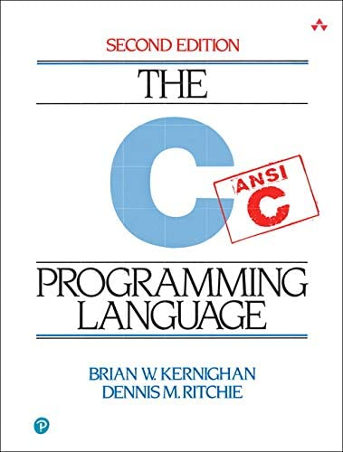
C Programming
Basic Input/Output using the C Standard Library

Slide 4
Standard C Library (libc)
In Lab0, you used printf() in the Hello World program
> printf("Hello world! x is currently %d \n", x);
> Hello world! x is currently 2
printf() stringified the arguments and printed to the standard output
formatted the string and filled-in the placeholders (e.g., %d)
Notice we didn’t need to implement that printf() function ourself
printf() is a function built-in to C’s standard I/O library
Hence, we needed to tell our compiler to make use of the standard library functions with #include <stdio.h>
You will talk about how the libraries are linked to your code in lecture soon
Notes:
stdout → the terminal

Slide 5
man gives us information about functions, commands, libraries
On most Unix/Unix-like systems, you can use man to learn more about functions/commands/etc.
The manual has the most accurate information about all the library functions, programs, commands, etc.
> Man printf
SCANF(3) Library Functions Manual SCANF(3)
NAME
printf, fprintf, ... , vsnprintf - formatted output conversion
SYNOPSIS
#include <stdio.h>
int printf(const char *restrict format, ...);
...
DESCRIPTION
The functions in the printf() family produce output according to a format as described below
...
If you are having trouble running man on Thoth
try: MANPATH= man 3 scanf

Slide 6
Detailed look at using printf()
int printf(const char * format string, ...);
Returns an integer: number of characters printed (excluding null terminator)
Remember, in C, a string is just an array of characters
We place placeholders which begin with a percent sign (%). The variables which comes after the formatter will replace the placeholders when printing
#include <stdio.h>
int main()
{
printf("Name: %s, Info:\n", ”John");
printf("\tAge: %d \t Ht: %g\n", 20, 5.9);
printf("\tYear: %d \t Dorm: %s\n", 3, “Towers”);
}
Name: John, Info:
Age: 20 Ht: 5.9
Year: 3 Dorm: Towers

Slide 7
Reading Input using scanf()
Like printf(), scanf() is another C standard library function
Used to read character, string, numeric data from keyboard
Again, if you want to use it in your program you have to include the header ( #include <stdio.h> )
int scanf(const char * format, ...)
Returns an integer: number of input items successfully matched and assigned
Passes by reference (a pointer) to the variable which will hold our input
Defines what we are reading (character? Integer? Float?)

Slide 8
Example code using scanf() _{(live demo)}
#include <stdio.h>
int main()
{
char ch;
int x;
printf("Enter any character \n");
scanf("%c", &ch);
printf("Entered character is %c \n", ch);
printf("Enter any integer\n");
scanf("%d", &x);
printf("Entered integer is %d", x);
return 0;
}
http://sites.pitt.edu/~shk148/teaching/CS0449-2234/code/scan.c.html

Slide 9
Lab 1: Data and Pointers
Practicing with data and input

Slide 10
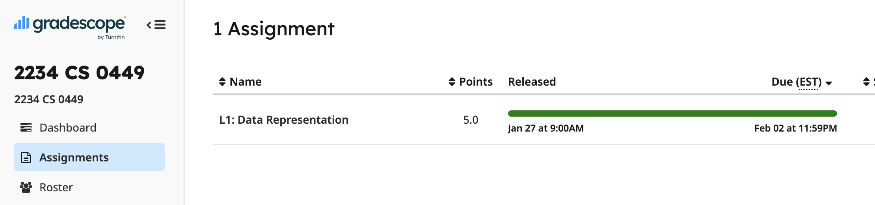
Part A: Practicing Data and Bitwise Manipulation
Collaboration: You are encouraged to work with one other person.
Your partner must be in the same recitation section
Select your partner’s name on Gradescope
Part A – Problems
See L1: Data Representation on Gradescope
Multiple choice, fill-in-the-blank type of questions

Slide 11
Part B1: Understanding sizeof()
TODO: Write a program that prints the size of three structs
REQUIREMENTS: create two files (size.c, size.h)
size.c has your implementation
size.h contains the structs
Expected output:
The size of struct A is #
The size of struct B is #
The size of struct C is #

Slide 12
Part B2: Understanding ternary operators
TODO: Implement the function ternary in ternary.c
int ternary(int cond, int true_value, int false_value) { /*...*/
}
Cannot use the ternary operator
Output of ternary should be the same as: cond?true_value:false_value
VARIABLE = CONDITION ? STATEMENT_1 : STATEMENT_2
if (CONDITION == TRUE) VARIABLE = STATEMENT_1
else if (CONDITION == FALSE) VARIABLE = STATEMENT_2

Slide 13
Part B3: Creating a simple calculator
Sample output:
Enter your calculation:
3 + 4
> 3 + 4 = 7
Enter your calculation: 3 c 4
Invalid calculation! "3 c 4"
Requirements
Create 1 files: calculator.c
Inputs must be read from keyboard (use scanf())
Support the following operations:
+, -, *, /, %(mod)
& (bitwise and), ~ (bitwise not)
If input is invalid, print output with same format as sample output

